Slide 1
ECON251 T01 Group 10
STUDENT NAME | WORKLOAD
KOH EE HUI JOSEPH (LEADER) | INTRODUCTION PILLAR 1: FDI AND EVIDENCE OF INDUSTRIALIZATION
Tun Lin Aung | PILLAR 2: THE INWARD FDI NETWORK
Arcega Ellexys Lyxanne San Agustin | PILLAR 3: DRIVERS OF FDI INFLOWS
Vincent | PILLAR 4: THE CHINA DYNAMIC (COLLABORATION VS COMPETITION)

Slide 2
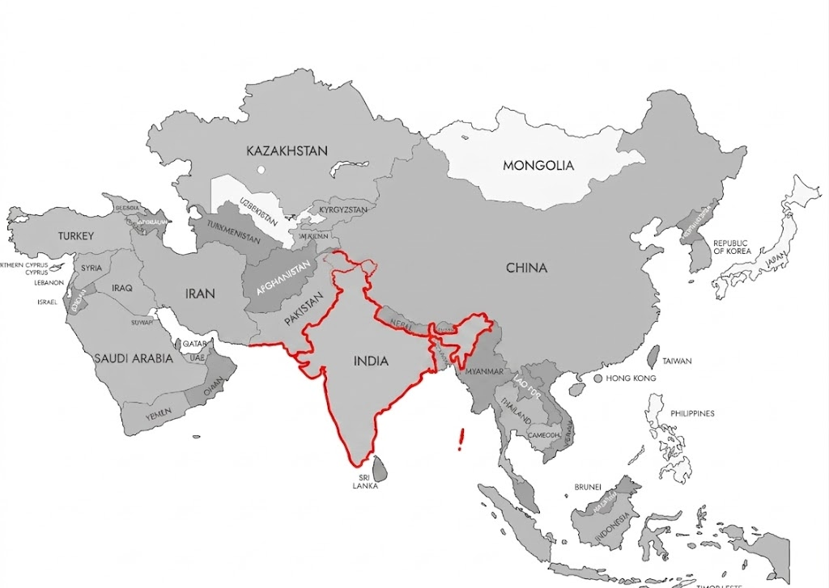
1. Introduction
Key Profile of the Host Economy:
India
GDP growth rate of 7.6%
GDP per capita of US$2523
Unemployment rate of 4.2%
Trade Openness 46.2%
Note: figures reflect the latest available year (2025), World Bank WDI.

Slide 3
1.1 key evidence of industrialisation
In 2010, there is a sharp drop in employment in Agriculture, while employment in services and industry gain a larger share
India is transitioning towards a service-led economy rather than a manufacturing economy

Slide 4
1.2 Effects of Industrialisation
R² = 0.0015 suggests that labour productivity alone is not a good predictor of manufacturing growth in India over 1991–2025
Manufacturing growth in India has been influenced by many other factors during this period:
Economic reforms (1991 liberalization)
Foreign direct investment (FDI)
Government initiatives (e.g., Make in India)
R² Value | Interpretation
0.00 – 0.30 | Weak or No Relationship
0.30 – 0.50 | Moderate Relationship
> 0.50 | Strong Relationship

Slide 5
1.2 Effects of Industrialisation
R² = 0.0211 suggests that Capital per Worker Growth alone is not a good predictor of manufacturing growth in India over 1992–2025
Manufacturing growth in India has been influenced by many other factors during this period:
Economic reforms (1991 liberalization)
Foreign direct investment (FDI)
Government initiatives (e.g., Make in India)
R² Value | Interpretation
0.00 – 0.30 | Weak or No Relationship
0.30 – 0.50 | Moderate Relationship
> 0.50 | Strong Relationship

Slide 6
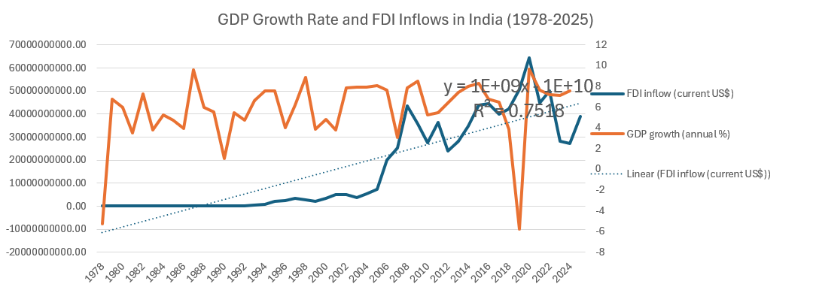
2. FDI growth and effects
R² = 0.7518 suggests that FDI inflows have a strong positive trend over time in India from 1978–2025.
FDI inflows in India have generally increased significantly over the period:
-Economic reforms (1991 liberalization)
-Global financial conditions (2008 Global Financial Crisis)
-Government initiatives (e.g., Make in India)
-COVID-19 pandemic (2020)
R² Value | Interpretation
0.00 – 0.30 | Weak or No Relationship
0.30 – 0.50 | Moderate Relationship
> 0.50 | Strong Relationship

Slide 7
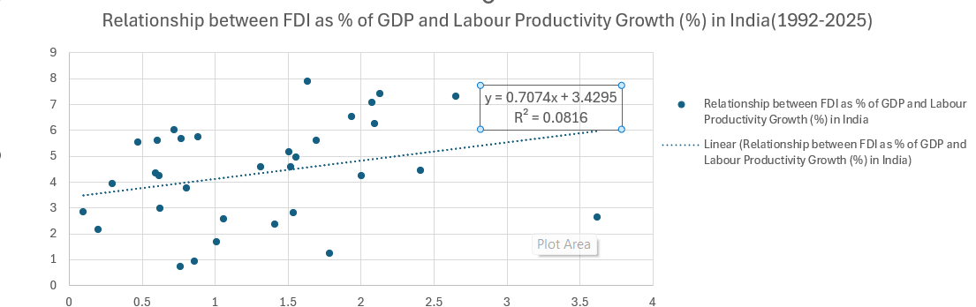
2. FDI growth and effects
R² = 0.0816 suggests that FDI as a percentage of GDP is not a strong predictor of labour productivity growth in India over 1992–2025.
The positive trend line indicates a weak positive relationship between FDI and labour productivity growth.
-Economic reforms and liberalisation
-Technological development
-Education and skills
-Government policies and investment
R² Value | Interpretation
0.00 – 0.30 | Weak or No Relationship
0.30 – 0.50 | Moderate Relationship
> 0.50 | Strong Relationship

Slide 8
3. Sources of FDI Inflow
The chart shows that Singapore, Mauritius, and the USA are India's top 3 FDI source countries
Singapore has become particularly important in recent years, while the contribution of Mauritius and the USA has fluctuated over time
Notes:
Source:
Overview of FDI countries in India
Step 1:
Go to official DPIIT website: https://www.dpiit.gov.in/documents/publications?page=1
Step 2:
Click VIEW ALL on FOREIGN DIRECT INVESTMENT IN INDIA - ANNUAL ISSUE 2025
Step 3:
Scroll down to CHAPTER – III: CUMULATIVEFDI EQUITY INFLOW DATA STATEMENTS (During January 2000 to December 2025)
Click VIEW on 2. Statement on Country-wise / Year-wise
Step 4:
Download the pdf file and convert to excel file
Top 3 Individual FDI Country – SG, MAURITUS, USA
CHAPTER - VI: FDI SYNOPSIS ON COUNTRY, SECTOR & STATE-WISE RECEIVED HIGHEST FDI EQUITY INFLOW
Country Profile: (period from January 2000 to December 2025)

Slide 9
3. Sources of FDI Inflow
India and Singapore have become more economically connected since 2000.
Both trade and FDI have grown strongly, despite some recent ups and downs.
Overall, the long-term trend suggests continued strengthening rather than a structural ceiling
Notes:
Source:
https://wits.worldbank.org/
https://wits.worldbank.org/CountryProfile/en/IND
Import:
https://wits.worldbank.org/CountryProfile/en/Country/IND/StartYear/2000/EndYear/2023/TradeFlow/Import/Indicator/MPRT-TRD-VL/Partner/SGP/Product/all-groups#
Export:
https://wits.worldbank.org/CountryProfile/en/Country/IND/StartYear/2000/EndYear/2023/TradeFlow/Export/Indicator/XPRT-TRD-VL/Partner/SGP/Product/All-Groups#

Slide 10
4.1 Drivers of FDI in India (Regression Table)
Time-series regression, 1976–2025 | Dependent variable: FDI inflows (current US$)
Variable | Coefficient | P-value | Result
Trade Openness (% GDP) | +US$966.8M | <0.001 | Significant (+)
Manufacturing (% GDP) | −US$4.01B | 0.004 | Significant (−)
GDP Growth (%) | −US$1.06B | 0.063 | Not significant
GFCF Growth (%) | −US$119.0M | 0.655 | Not significant
Intercept | +US$57.0B | 0.015 | Significant
R² = 0.763 | Adjusted R² = 0.742 | N = 50 | Model p-value < 0.001

Slide 11
4.2 Drivers of FDI in India (Key Findings)
TRADE OPENNESS ↑
Strongest positive driver
+US$966.8M per 1%-point increase
p < 0.001
MANUFACTURING ↓
Significant negative relationship
−US$4.01B per 1%-point increase
p = 0.004
OTHER FACTORS
GDP Growth → Not significant (p = 0.063)
GFCF Growth → Not significant (p = 0.655)
OVERALL FINDING: R² = 0.763 → Model explains 76.3% of variation in FDI inflows
Trade openness is the clearest positive FDI driver.

Slide 12
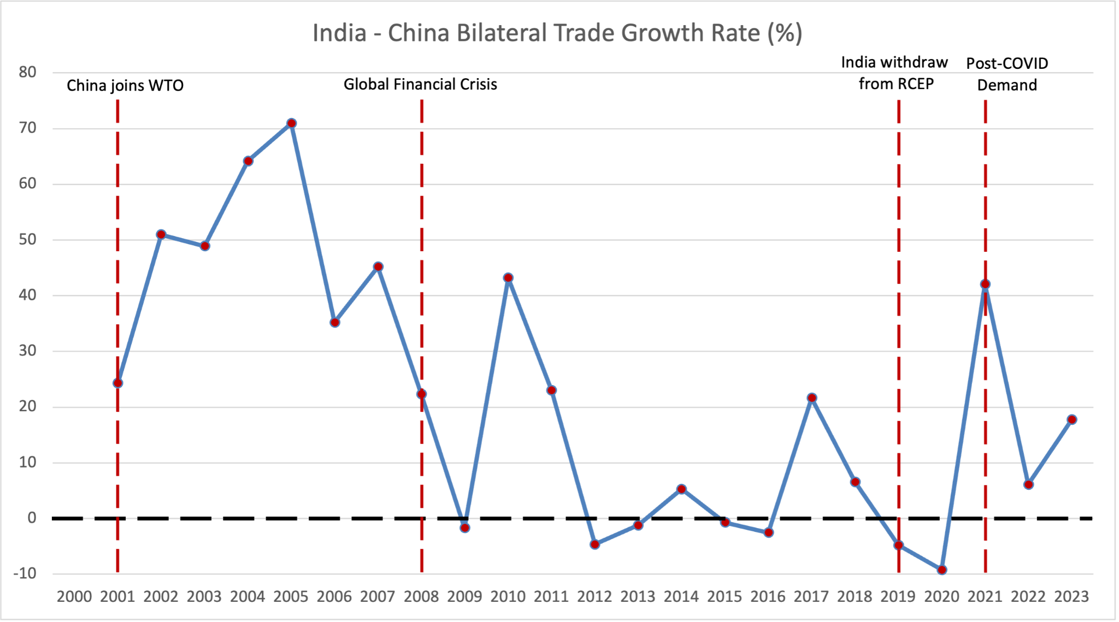
5. THE CHINA DYNAMIC (COLLABORATION VS. COMPETITION)
Since China joined WTO in 2001, bilateral trade between India and China has grown drastically.
The Global Financial Crisis in 2008 caused trade to decrease abruptly into the negative zone.
When India withdrew from RCEP in 2019, it also caused a decrease in the trade before then spiking up again in 2021 due to post-COVID demands.

Slide 13
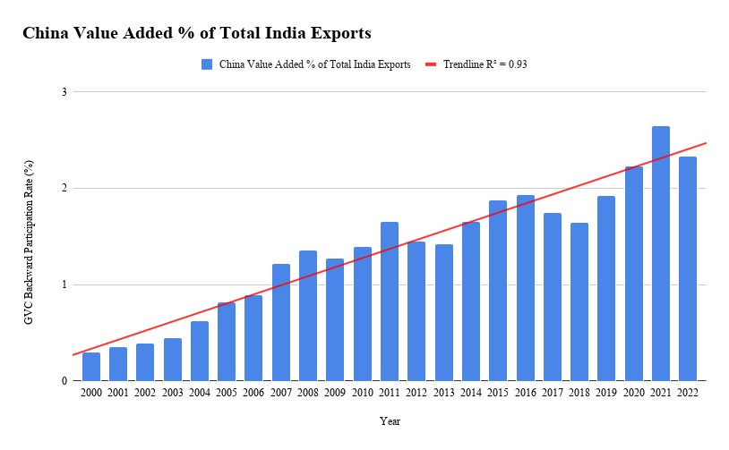
6. Long term relationship with China
India’s relationship with China involves both Competition and Collaboration.
The trendline with the R2 being 0.93 and showing a steady increase in the GVC backward participation rate indicates that over the years, India’s total exports has become more reliant on China value-added inputs.
While India competes to capture global manufacturing market share via the “China+1” strategies, its exports still rely on collaboration with inputs from China.

